Slide 1
Discrete Mathematics and Its Application
7th edition, 2001
Kenneth H. Rosen

Slide 2
Welcome to
Discrete Mathematics
Spring 2018
Instructor: Niu Shao Zhang

Slide 3
Textbook & References
Textbook
Kenneth H. Rosen, Discrete Mathematics and Its Applications/7e, McGraw-Hill, 2012
石纯一 等，数理逻辑与集合论/2e，清华大学出版社，2000
References
Kolman B. et al, Discrete Mathematical Structures/4e, Prentice Hall, 2001
Liu, C.L. Elements of Discrete Mathematics, New York, McGraw-Hill, 1977
陈崇昕 等，离散数学，北京邮电大学出版社，1992
王湘浩 等，离散数学，高等教育出版社，1983
朱一清 编著，离散数学，电子工业出版社，1997
戴一奇 等，图论与代数结构，清华大学出版社，1992
College of Computer Science, BUPT

Slide 4
Why Care about Discrete Math?
Digital computers are based on discrete “atoms” (bits).
Therefore, both a computer’s
  structure (circuits) and
  operations (execution of algorithms)
can be described by discrete math.

Slide 5
Logic
Logic = the study of correct reasoning
Use of logic
  In mathematics:
    to prove theorems
  In computer science:
    to prove that programs do what they are supposed to do

Slide 6
Propositional logic
(命题逻辑）
Logic is a system based on propositions.
A proposition is declarative sentence（陈述句） that can be determined to be either true or false.
Two factors:
  a declarative sentence
  can be determined to be either true or false

Slide 7
The Statement/Proposition Game
“this Proposition is false.”
Is this a statement?
yes
Is this a proposition?
?
What is the truth value
of the proposition?
?

Slide 8
Example
‘the moon is made of green cheese’
‘go to town!’ X – imperative(祈使句)
‘What time is it?’ X - interrogative(疑问句)
College of Computer Science & Technology, BUPT

Slide 9
Example
Which of the following are statements?
  (a) The earth is round.
  (b) 2+3=5
  (c) Do you speak English?
  (d) x>5
  (e) Take two aspirins.
(f) The temperature on the surface of the planet Venus(金星) is 800ºF.
  (g) The sun will come out tomorrow.
  (h) 101+1=110
College of Computer Science & Technology, BUPT

Slide 10
Logical Connectives and Compound Statements (逻辑联结词与复合命题）
propositional variables（命题变项）: p,q, r,s, . . .
  p: The sun is shining today.
  q: It is cold.
Statements or propositional variables can be combined by logical connectives（逻辑联结词） to obtain compound statements(复合命题).
  p and q: The sun is shining and it is cold.
College of Computer Science & Technology, BUPT

Slide 11
Connectives
If p and q are propositions, new compound propositions can be formed by using connectives
Most common connectives:
  Negation Symbol ~ ¬
  Conjunction AND. Symbol ∧
  Inclusive disjunction OR Symbol v
  Exclusive disjunction OR Symbol ⊕ or v
  Implication Symbol →
  Double implication Symbol ↔

Slide 12
Note
The truth value of a compound statement depends only on the truth value of the statement being combined and on the type of connectives being used.
College of Computer Science & Technology, BUPT

Slide 13
Calculus of propositions（命题演算）
New Propositions from old: calculus of propositions - relate new propositions to old using TRUTH TABLES(真值表）.
Truth table: a table giving the truth values of a compound statement in terms of its component part.
College of Computer Science & Technology, BUPT

Slide 14
Negation ‘not’ : ∼ 否定
Definition:the negation of the statement p is the statement not p,denoted by ~p.
Example:
  p: I am going to town
  ∼p:
  I am not going to town;
  It is not the case that I am going to town;
Truth Table:
  p ∼p
  F (0) T (1)
  T (1) F (0)
College of Computer Science & Technology, BUPT

Slide 15
Negation
Negation of p: in symbols ~p
~p is false when p is true, ~p is true when p is false
  Example: p = "John is a programmer"
  ~p = "It is not true that John is a programmer"
p | ~p
T | F
F | T

Slide 16
Example
Give the negation of the following statement:
  (a) p: 2+3>1
  (b) q: It is cold.
College of Computer Science & Technology, BUPT

Slide 17
Conjunction ‘and’ : ∧（合取）
Definition: If p and q are statements,the conjunction of p and q is the compound statement “p and q”,denoted by p∧q.
  The connective and is denoted by the symbol ∧.
Example
p - ‘I am going to town’
q - ‘It is going to rain’
College of Computer Science & Technology, BUPT

Slide 18
Truth table of conjunction
The truth values of compound propositions can be described by truth tables.
Truth table of conjunction
p ^ q is true only when both p and q are true.
p | q | p ∧ q
T | T | T
T | F | F
F | T | F
F | F | F

Slide 19
Conjunction ‘and’ : ∧
p∧q: ‘I am going to town and it is going to rain.’
Truth Table:
  p q p∧q
  0 0 0
  0 1 0
  1 0 0
  1 1 1
  Note: Both p and q must be true!!!!!
College of Computer Science & Technology, BUPT

Slide 20
Example
Let p = “Tigers are wild animals”
Let q = “Chicago is the capital of Illinois”
p ∧ q = "Tigers are wild animals and Chicago is the capital of Illinois"
p ∧ q is false. Why?
The capital of Illinois is Springfield

Slide 21
Truth table of disjunction
The truth table of (inclusive) disjunction is
p ∨ q is false only when both p and q are false
  Example: p = "John is a programmer", q = "Mary is a lawyer"
  p v q = "John is a programmer or Mary is a lawyer"
p | q | p v q
T | T | T
T | F | T
F | T | T
F | F | F

Slide 22
Disjunction （析取） inclusive ‘or’(可兼或）: ∨
Definition: If p and q are statements, the disjunction of p and q is the compound statement “p or q”,denoted by p ∨ q.
  The connective or is denoted by the symbol ∨
Example:
p - ‘I am going to town’
q - ‘It is going to rain’
p∨q: ‘I am going to town or it is going to rain.’
College of Computer Science & Technology, BUPT

Slide 23
Disjunction
Exclusive ‘or’: ⊕
Truth Table:
  p q p⊕q
  0 0 0
  0 1 1
  1 0 1
  1 1 0
  Note: Only one of p and q must be true.
College of Computer Science & Technology, BUPT

Slide 24
可兼或与不可兼或
可兼或：明天下雨或刮风。
不可兼或：
  今天晚上去电影院看电影，或在家看电视。
  今天第一节课是语文课或数学课。
  他现在在301室或302室。
College of Computer Science & Technology, BUPT

Slide 25
Exclusive disjunction
“Either p or q” (but not both), in symbols p ⊕ q
p ⊕ q is true only when p is true and q is false, or p is false and q is true.
  Example: p = "John is programmer, q = "Mary is a lawyer"
  p ⊕ q = "Either John is a programmer or Mary is a lawyer"
p | q | p ⊕ q
T | T | F
T | F | T
F | T | T
F | F | F

Slide 26
Logical operators
A proposition is a statement that is either true or false, but not both
Let p, q, r be simple statements
Logical operators (connectives) to form new proposition
  ~ ¬P, P∧Q, P∨Q, P⊕Q, v
  negation , conjunctions, disjunctions, exclusive or

Slide 27
More compound statements
Let p, q, r be simple statements
We can form other compound statements, such as
  (p∨q) ∧ r
  p∨(q ∧ r)
  (~p)∨(~q)
  (p∨q) ∧ (~r)
  and many others…

Slide 28
Conditional propositions
A conditional proposition is of the form
“If p then q”
In symbols: p → q
Example:
  p = " John is a programmer"
  q = " Mary is a lawyer "
  p → q = “If John is a programmer then Mary is a lawyer"

Slide 29
Implication ‘If...then...’: →
Equivalent forms:
  If p, then q ￭ p implies q
  If p, q ￭ p only if q
  p is a sufficient condition(充分条件） for q
  a sufficient condition for q is p
  q if p ￭ q whenever p
  q when p ￭ q follows from p
  q is a necessary condition （必要条件）for p
  q unless not p
Note: The implication is false only when p is true and q is false!
College of Computer Science BUPT

Slide 30
Truth table of p → q
p | q | p → q
T | T | T
T | F | F
F | T | T
F | F | T
p → q is true when both p and q are true
or when p is false

Slide 31
Truth table of p → q
p | q | p → q
T | T | T
T | F | F
F | T | T
F | F | T
If p is false, then p → q is always true whenever q is true or false. Why?

Slide 32
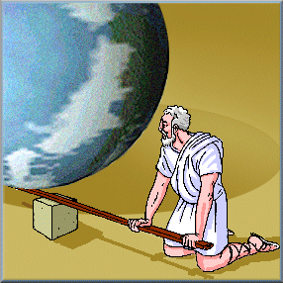
Truth table of p → q
“If you give me a place to
stand, I will move the earth.”
– Archimedes (~ 250BC)

Slide 33
Terminology
  p = premise（前提）, hypothesis, antecedent
  q = conclusion, consequence
More terminology:
  q →p is the CONVERSE（逆） of p → q
  ∼q → ∼p is the CONTRAPOSITIVE （逆反式）of p → q
  ∼p → ∼q is the INVERSE（反式）of p→ q
  One of these three has the same meaning (same truth table) as p → q. Can you figure out which?
College of Computer Science, BUPT

Slide 34
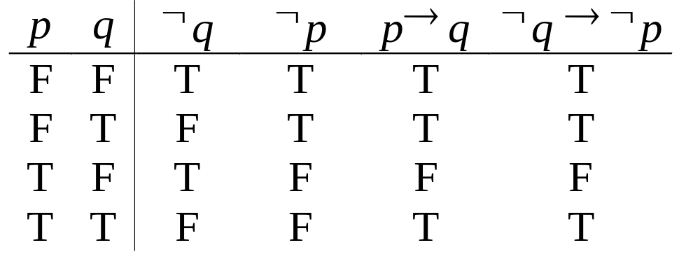
How do we know for sure?
Topic #1.0 – Propositional Logic: Operators
Proving the equivalence of p → q and its contrapositive using truth tables:
College of Computer Science BUPT

Slide 35
Implication ‘If...then...’: →
There is no causality（因果关系） implied here!
  ‘If the moon is made of green cheese then I have more money than Bill Gates’ (T)
  ‘If the moon is made of green cheese then I’m on welfare’ (T)
  ‘If 1+1=3 then your grandma wears combat boots’ (T)
  ‘If I’m wealthy then the moon is not made of green cheese.’ (T)
  ‘If I’m not wealthy then the moon is not made of green cheese.’ (T)
College of Computer Science BUPT

Slide 36
Example
Find the converse, inverse and contrapositive of the following statement:
R: ‘Raining tomorrow is a sufficient condition for my not going to town.’
Step 1: Assign propositional variables to component propositions
  p: It will rain tomorrow
  q: I will go to town
College of Computer Science & Technology, BUPT

Slide 37
Example
Step 2: Symbolize the assertion
  R: p → ~q
Step 3: Symbolize the converse
  ~q →p
Step 4: Convert the symbols back into words
  ‘If I don’t go to town then it will rain tomorrow’
  or
  ‘Raining tomorrow is a necessary condition for my not going to town.’
  or
  ‘My not going to town is a sufficient condition for it raining tomorrow.’
College of Computer Science BUPT

Slide 38
Necessary and sufficient
A necessary condition is expressed by the conclusion.
A sufficient condition is expressed by the hypothesis.
  Example:
If John is a programmer then Mary is a lawyer"
  Necessary condition: “Mary is a lawyer”
  Sufficient condition: “John is a programmer”

Slide 39
Biconditional
‘if and only if’, ‘iff’: ↔(等价)
Definition: If p and q are statements,the compound statement p if and only if q,denoted p ↔ q ,is called an equivalence(等价） or biconditional（双条件命题）.
  The connective if and only if is denoted by the symbol ↔ .
Example:
  p - ‘I am going to town’
  q - ‘It is going to rain’
  p ↔ q: ‘I am going to town if and only if it is going to rain.’
College of Computer Science BUPT

Slide 40
Biconditional
‘if and only if’, ‘iff’: ↔
Truth Table:
  p q p ↔ q
  0 0 1
  0 1 0
  1 0 0
  1 1 1
  Note: Both p and q must have the same truth value.
College of Computer Science BUPT

Slide 41
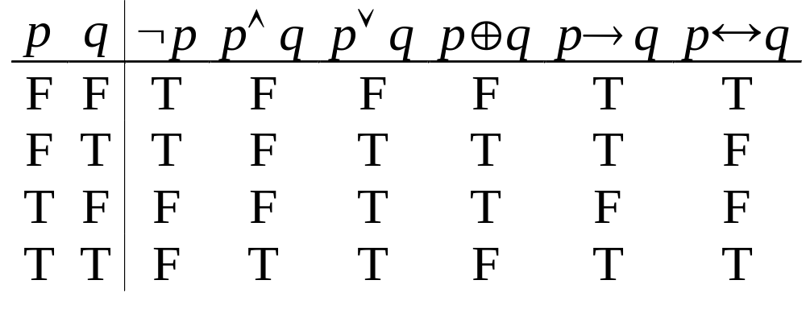
Boolean Operations Summary
Topic #1.0 – Propositional Logic: Operators
We have seen 1 unary operator (out of the 4 possible) and 5 binary operators (out of the 16 possible). Their truth tables are below.
College of Computer Science BUPT
Notes:
For fun, try writing down the truth tables for each of the 4 possible unary operators, and each of the 16 possible binary operators. For each one, try to come up with an English description of the operator that conveys its meaning. Also, figure out a way to define it in terms of other operators we already introduced.

Slide 42
Precedence of logical operators
~
∧, ⊕ , ∨
→, ↔
College of Computer Science BUPT

Slide 43
Logical operators
A proposition is a statement that is either true or false, but not both
Let p, q, r be simple statements
Logical operators (connectives) to form new proposition
  ~ ¬p, p∧q, p∨q, p⊕q (p v q), p→q, p↔q
    negation , conjunctions, disjunctions, exclusive or, implications, two-way

Slide 44
Logic and Bit Operations
Topic #2 – Bits
A bit is a binary (base 2) digit: 0 or 1.
Bits may be used to represent truth values.
By convention:
0 represents “false”; 1 represents “true”.
Boolean algebra is like ordinary algebra except that variables stand for bits, + means “or”, and multiplication means “and”.
College of Computer Science BUPT
Notes:
Bits can also be defined in terms of sets, if you like, by the convention that the empty set {} represents 0, and the set containing the empty set {{}} represents 1. Or more generally, any two distinct objects can represent the two bit-values or truth-values.

Slide 45
Bit Strings
Topic #2 – Bits
A Bit string of length n is an ordered sequence (series, tuple) of n≥0 bits.
  More on sequences in §2.4
By convention, bit strings are (sometimes) written left to right:
  e.g. the “first” bit of the bit string “1001101010” is 1.
  Watch out! Another common convention is that the rightmost bit is bit #0, the 2nd-rightmost is bit #1, etc.
When a bit string represents a base-2 number, by convention, the first (leftmost) bit is the most significant bit. Ex. 1101₂=8+4+1=13.
College of Computer Science BUPT
Notes:
We will talk about strings more generally later in the module on sequences.

Slide 46
Counting in Binary
Topic #2 – Bits
Did you know that you can count
to 1,023 just using two hands?
  How? Count in binary!
    Each finger (up/down) represents 1 bit.
To increment: Flip the rightmost (low-order) bit.
  If it changes 1→0, then also flip the next bit to the left,
    If that bit changes 1→0, then flip the next one, etc.
0000000000, 0000000001, 0000000010, …
…, 1111111101, 1111111110, 1111111111
College of Computer Science BUPT
Notes:
This is just a fun exercise to practice with the binary number system. We’ll have more to say about binary (and base-n numbers in general) later in the course. If you demonstrate this technique, you should probably apologize to your audience when you get to 4.
The sequence in the last bullet is (in decimal): 0, 1, 2, … (skip a bunch) …, 1021, 1022, 1023. The next number, 1024 (or 1K) is 2^10. You would need 11 fingers to show it!

Slide 47
Bitwise Operations
Topic #2 – Bits
Boolean operations can be extended to operate on bit strings as well as single bits.
E.g.:
01 1011 0110
11 0001 1101
11 1011 1111 Bit-wise（逐位） OR
01 0001 0100 Bit-wise （逐位） AND
10 1010 1011 Bit-wise （逐位） XOR
College of Computer Science BUPT
Notes:
The answers are present, but hidden, as white text on a white background. The slide can be done in class as an exercise, with the instructor typing in the students’ answers in the space provided. Then the correct answers can be revealed by selecting the bottom 3 rows and changing their font color unconditionally to black.

Slide 48
End of §1.1
You have learned about:
Propositions: What they are.
Propositional logic operators’
  Symbolic notations.
  English equivalents.
  Logical meaning.
  Truth tables.
Atomic vs. compound propositions.
Bits and bit-strings.
College of Computer Science BUPT

Slide 49
Homework
P12
2,12,14,26,30,38
College of Computer Science BUPT

